Slide 1
Defensive Security Project
by: David Contreras

Slide 2
Table of Contents
This document contains the following resources:
Monitoring Environment
Attack Analysis
Project Summary & Future Mitigations

Slide 3

Monitoring Environment
‹#›

Slide 4
Scenario
Building a Security Monitoring Solution for VSI’s Hybrid Infrastructure
Detect and respond to security threats in real-time
Visualize server activity and user behavior
Proactively identify system failures or misuse
Improve auditing and compliance

Slide 5
Logs Analyzed
Windows Logs
Apache Logs
1
2
The logs represent routine activity generated by VSI's Windows systems.
They include Windows security event logs that capture authentication attempts, user actions, and system-level events occurring within the organization's infrastructure."
The logs reflect routine activity from VSI's Apache Web Server, capturing all interactions with the web applications it hosts.
These logs include access requests, error messages, and other critical data that provide visibility into user behavior and server performance.

Slide 6
Windows Logs
‹#›

Slide 7
Reports—Windows
Designed the following reports:
Report Name | Report Description
windows_server_signatures | This report creates a table with signatures and associated signature ID’s removing duplicates.
windows_server_severity_chart_p3 | This report displays the severity levels and the count and percentages of each.
windows_server_status_p3 | This report provides a comparison between the success and failure of Windows Activities.

Slide 8
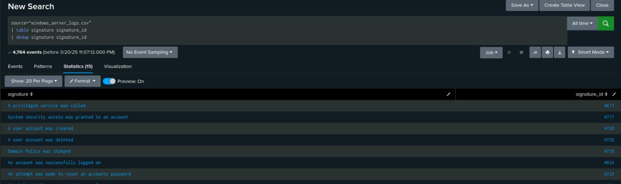
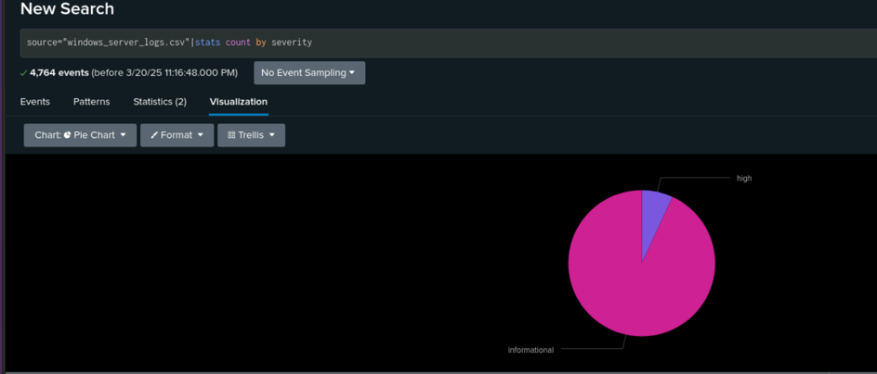
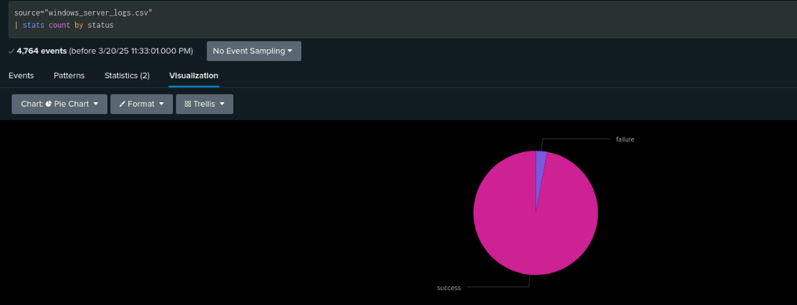
Images of Reports—Windows

Slide 9
Alerts—Windows
Designed the following alerts:
Alert Name | Alert Description | Alert Baseline | Alert Threshold
Windows_server_status_p3 | server status alert | 10 | greater than 15
The logs indicate an average rate of failed status activity at approximately 10 or fewer occurrences per hour. This is considered the normal baseline. A threshold of 15 or more failed activity per hour is defined as anomalous behavior and may indicate a potential issue requiring further investigation.

Slide 10
Alerts—Windows
Designed the following alerts:
Alert Name | Alert Description | Alert Baseline | Alert Threshold
windows_server_signature_id_4624 | Hourly count of successfully logged on | 8 | less than 5
The logs show an average number of logged on users to be above 8. A threshold of 5 or less users will trigger the alert as this may indicate a deviation from normal operational patterns.

Slide 11
Alerts—Windows
Designed the following alerts:
Alert Name | Alert Description | Alert Baseline | Alert Threshold
windows_server_signature_id_4726 | User account deleted | 22 | greater than 30
The logs indicate an average rate of user account deletion to be no more than 22 or fewer occurrences per hour. This is considered the normal baseline. A threshold of 30 or more accounts deleted per hour is defined as anomalous behavior and indicates further investigation.

Slide 12
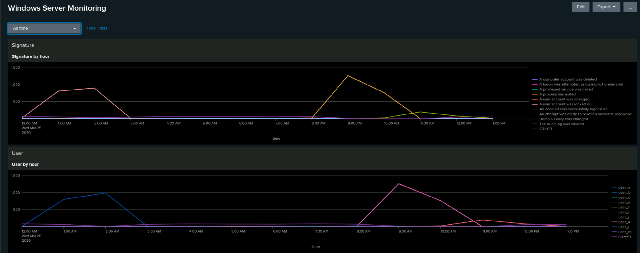
Dashboards—Windows

Slide 13
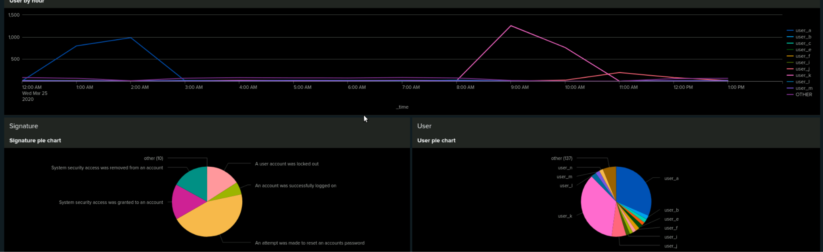
Dashboards—Windows

Slide 14
Apache Logs
‹#›

Slide 15
Reports—Apache
Designed the following reports:
Report Name | Report Description
http_methods_aginst_web_server | HTTP methods table
http_refer_domain_top10 | Top 10 domains that refer to VSI’ website
http_status_counts | Count of each HTTP response codes

Slide 16
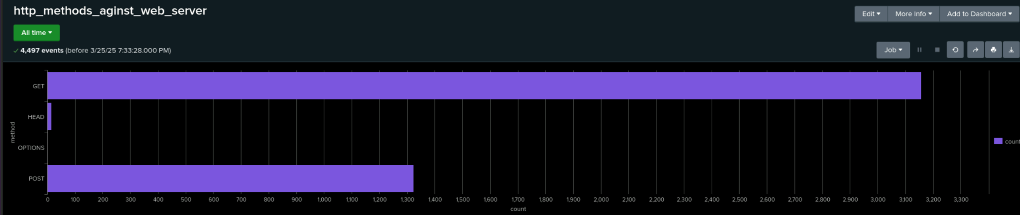
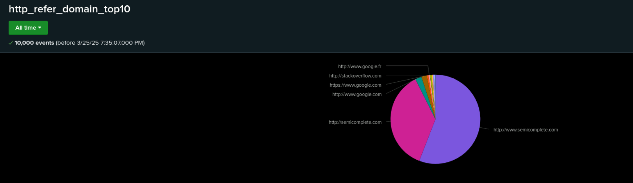
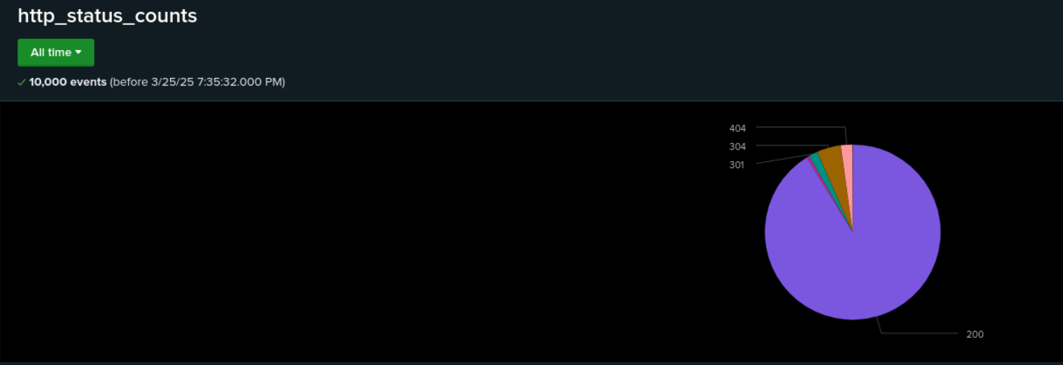
Images of Reports—Apache

Slide 17
Alerts—Apache
Designed the following alerts:
Alert Name | Alert Description | Alert Baseline | Alert Threshold
apache_activity_not_us | Activity not from US | 120 | greater than 200
The logs show that activity originating from countries outside the United States typically remains at or below 120 events per hour. Any significant increase beyond this baseline may indicate suspicious behavior or a potential attack originating from foreign sources.

Slide 18
Alerts—Apache
Designed the following alerts:
Alert Name | Alert Description | Alert Baseline | Alert Threshold
apache_method_post | HTTP method post count | 10 | greater than 20
The POST method is commonly used to submit form data and, in a RESTful API environment, to create new resources. A sudden or unusual spike in POST requests may indicate a potential attack on the application, such as automated abuse, brute-force attempts, or exploitation of input handling vulnerabilities.

Slide 19
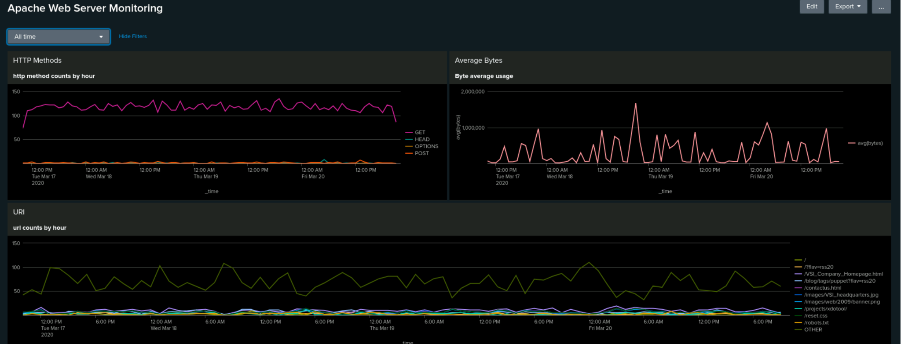
Dashboards—Apache

Slide 20
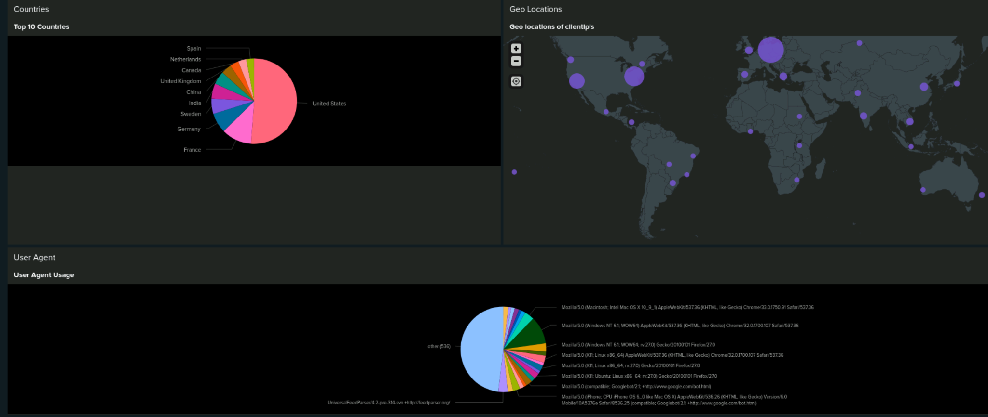
Dashboards—Apache

Slide 21
Attack Analysis
‹#›

Slide 22
Attack Summary—Windows
Summarize your findings from your reports when analyzing the attack logs.
The severity count increased from 329 to 1,111, and a rise from 6.91% to 20.22% of the total. This significant increase is indicative of potentially suspicious activity and warrants immediate investigation.
While the number of failed activities decreased from 142 to 93, the total volume of activity increased significantly from 4,764 to 5,949. This pattern may indicate a shift in attacker tactics, such as a move from unsuccessful attempts to more successful or stealthy interactions.

Slide 23
Attack Summary—Windows
Summarize your findings from your alerts when analyzing the attack logs. Were the thresholds correct?
A server status alert was triggered due to the number of failures exceeding the defined threshold of 15. At 8:00 AM, a total of 35 failed events were detected, indicating potential system issues or unauthorized access attempts.
An alert for successful logins was triggered at 9:00 AM due to a sudden drop in the number of logged-in users, decreasing from 4 to 0. This abrupt change may indicate a service disruption or an abnormal user behavior pattern that requires further investigation.
The deleted accounts warning was not triggered the only anomaly was that at 10 AM it goes to 0.

Slide 24
Attack Summary—Windows
Summarize your findings from your dashboards when analyzing the attack logs.
The dashboard analysis revealed suspicious activity tied to specific security events and user behavior. Notably, there were significant spikes in two key signatures:
"A user account was locked out" occurred between 12:00 AM and 3:00 AM, peaking at 896 events.
"An attempt was made to reset an account password" was observed between 8:00 AM and 11:00 AM, with a peak count of 1,258 events.
These signature spikes correlate with increased activity from two specific users:
user_a, active from 12:00 AM to 3:00 AM, reached a peak of 984 events.
user_k, active from 8:00 AM to 11:00 AM, peaked at 1,256 events.
The timing and volume of these activities suggest potential unauthorized access attempts or account abuse and warrant further investigation into the actions of these users and the nature of the events.

Slide 25
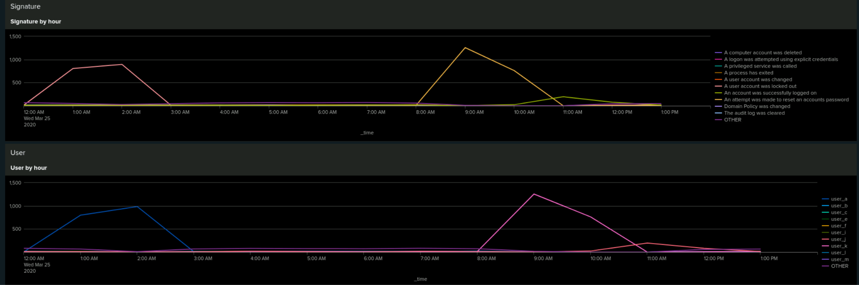
Screenshots of Attack Logs

Slide 26
Attack Summary—Apache
Summarize your findings from your reports when analyzing the attack logs.
The number of POST requests increased significantly. Since the POST method is commonly used to submit form data or create resources, this spike may indicate a potential attack or misuse of the application."
From the refer domain report we have 2 new sites tuxradar.com and logstash.net
The status report has some new return codes like 500 and 403, 500 is an internal server error that could indicate problems with the server.

Slide 27
Attack Summary—Apache
Summarize your findings from your alerts when analyzing the attack logs. Were the thresholds correct?
An alert for activity originating from countries outside the United States was triggered due to a spike of 937 events detected from 8:00 PM to 9 PM, with Ukraine identified as the primary source.
The alert for POST methods was triggered due to a spike of 1,296 events recorded between 8:00 PM and 9:00 PM

Slide 28
Attack Summary—Apache
Summarize your findings from your dashboards when analyzing the attack logs.
Time of Incident: Activity spike observed at 8:00 PM.
Indicators of Attack:
Significant increase in POST method activity.
1,296 requests made to the endpoint VSI_Account_logon.php.
The identical count for both POST requests and hits to the login endpoint suggests a focused attack on the login form.
Geolocation Insights:
The geolocation dashboard and top 10 source countries reveal a notable increase in traffic from Ukraine.
User Agent Correlation:
The traffic associated with the spike used the following user agent string: Mozilla/4.0 (compatible; MSIE 6.0; Windows NT 5.2; SV1; .NET CLR 2.0.50727987787; Inf
This pattern strongly suggests the use of automated tools or scripted attacks emulating older browser agents.

Slide 29
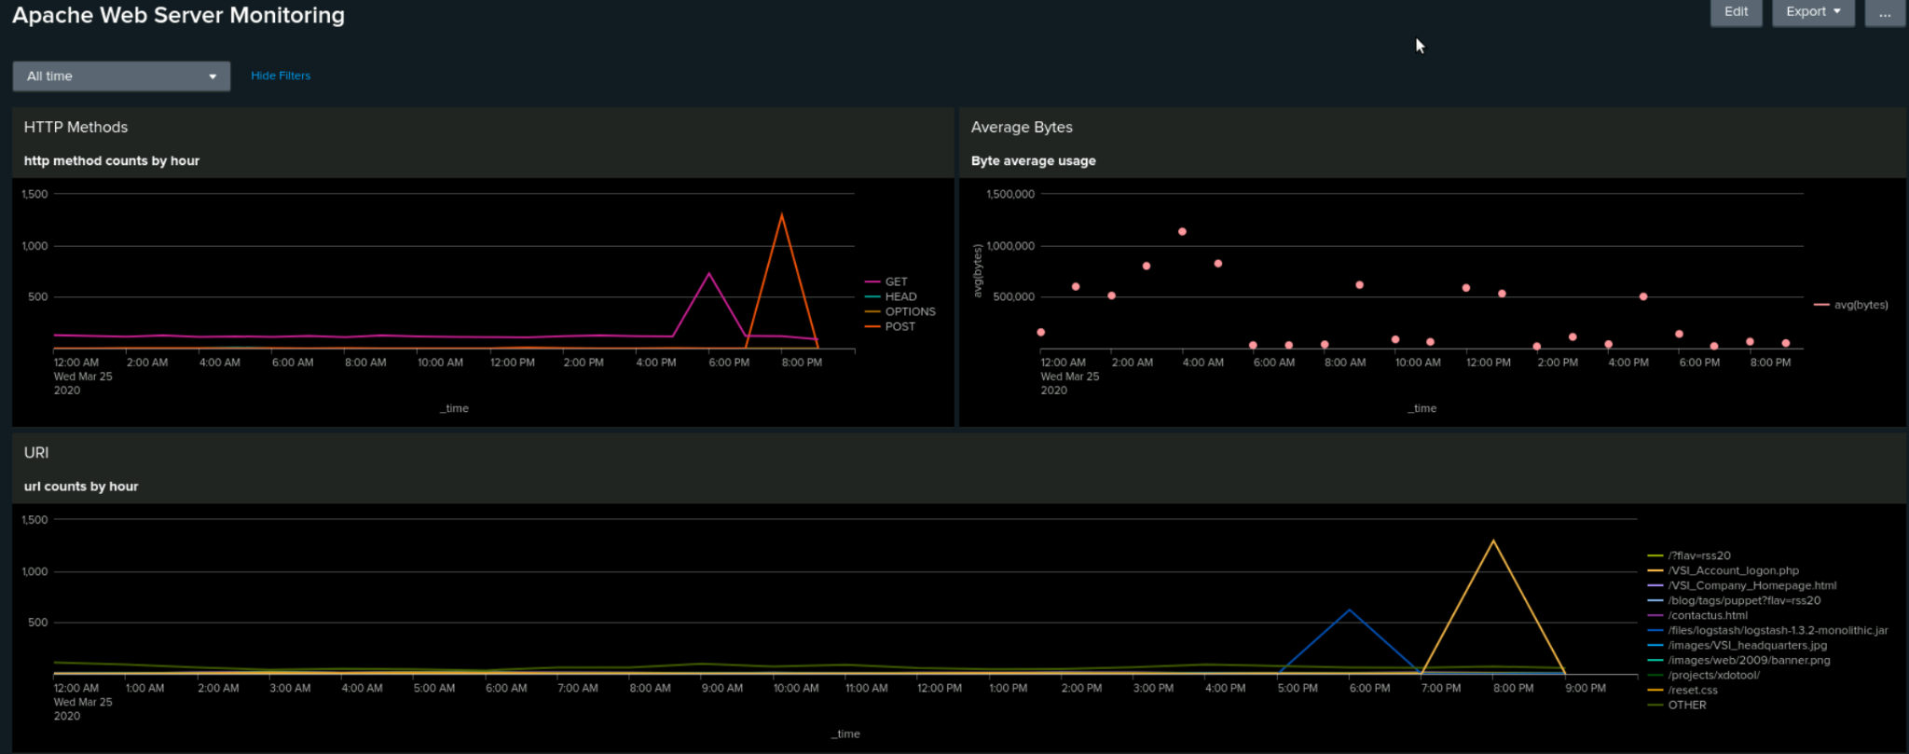
Screenshots of Attack Logs

Slide 30
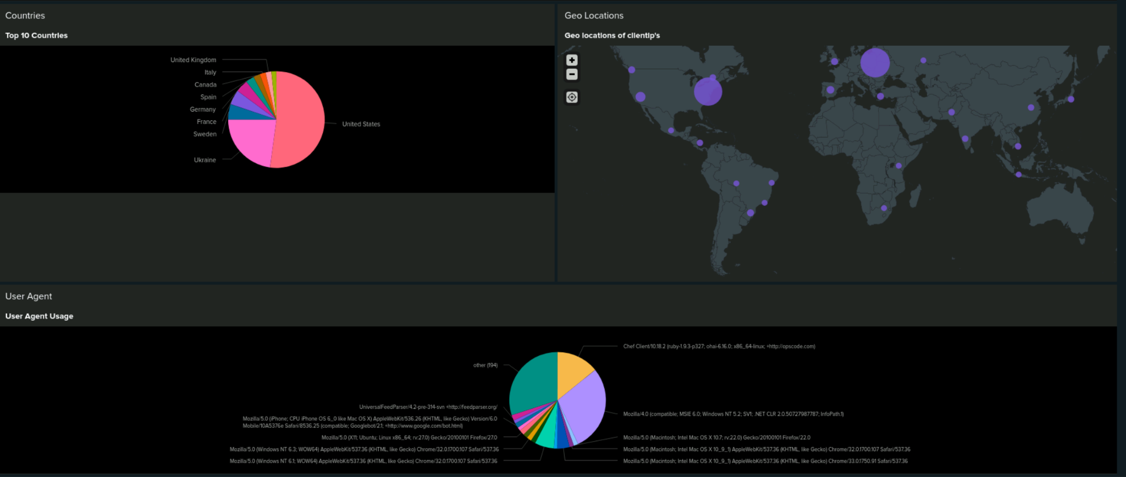
Screenshots of Attack Logs

Slide 31
Summary and Future Mitigations
‹#›

Slide 32
Project 3 Summary
What were your overall findings from the attack that took place?
The timing, volume, and origin of these activities suggest coordinated unauthorized access attempts.
Significant spikes in account-related events
Targeted Login Form Exploitation
Coordinated and Timed Attack Patterns
To protect VSI from future attacks, what future mitigations would you recommend?
Immediate investigation is recommended, with a focus on:
Validating affected user accounts and access logs
Reviewing firewall and WAF rules
Implementing rate-limiting or CAPTCHA mechanisms on login endpoints
Blocking or geo-fencing traffic from high-risk locations as appropriate

